Slide 1
Group 3.

Slide 2
Content
1. Dataset & Preprocessing
2. Statistical analysis & Conclusion

Slide 3
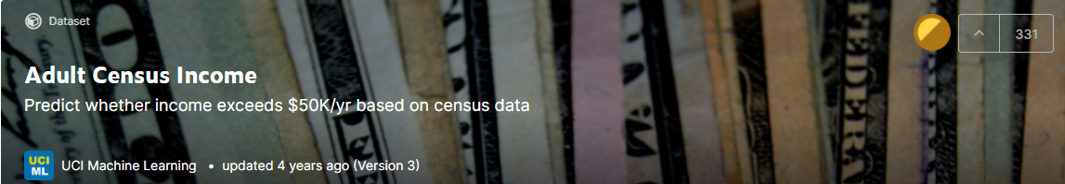
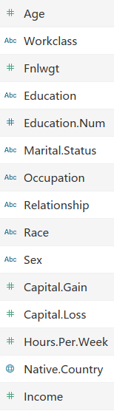
Dataset Preprocessing
Adult Census Income from kaggle

Slide 4
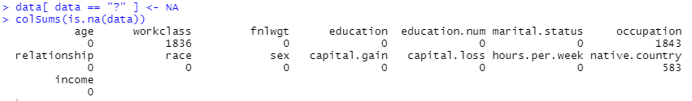
Dataset Preprocessing
Missing data
Label our features

Slide 5
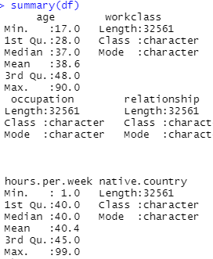
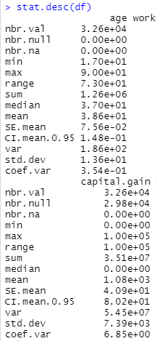
Statistical analysis
Holistic understanding of the data

Slide 6
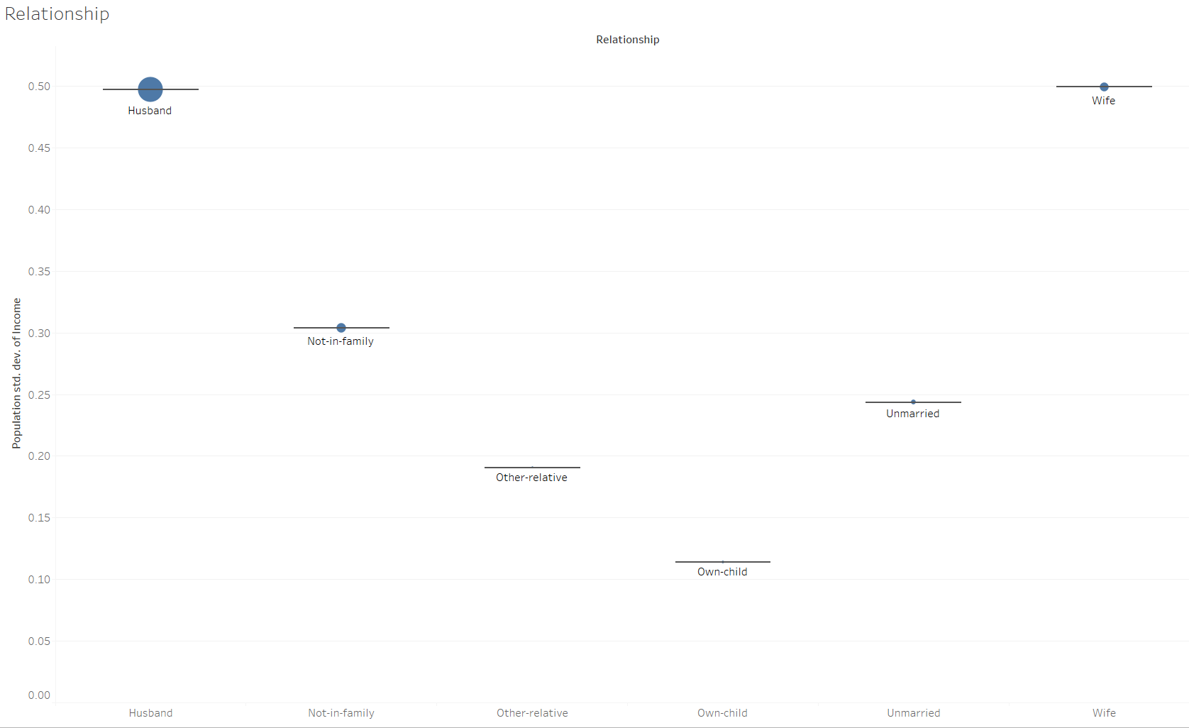
Statistical analysis
Husband’ s income varies a lot
6

Slide 7
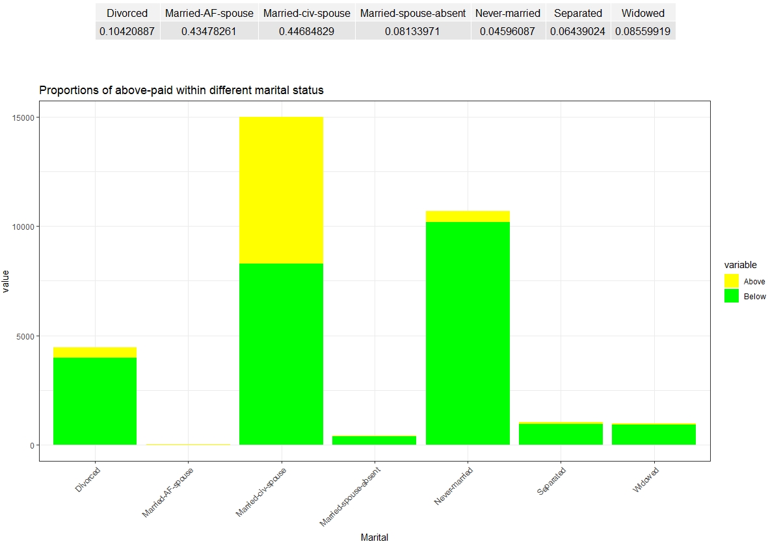
Statistical analysis
7

Slide 8
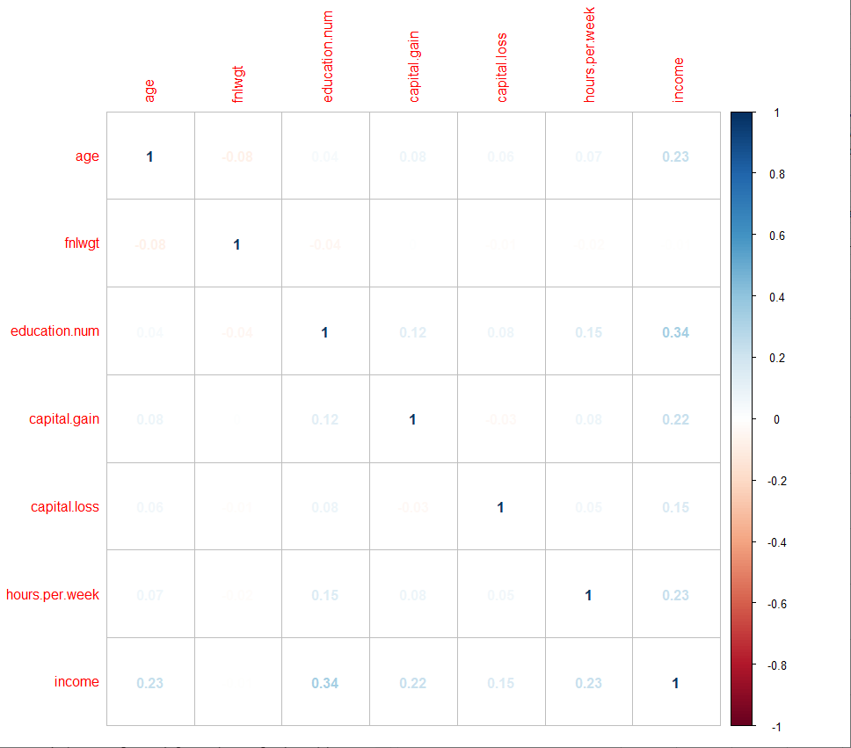

Statistical analysis
Important factors: 1. Education 2. Age
8

Slide 9
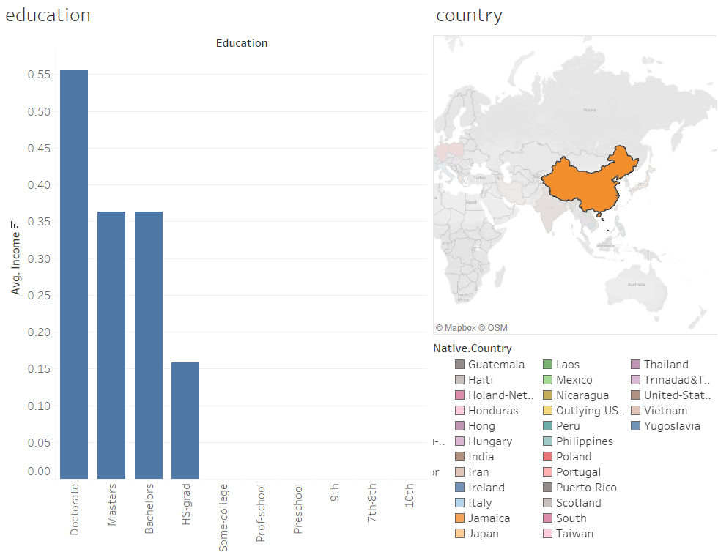
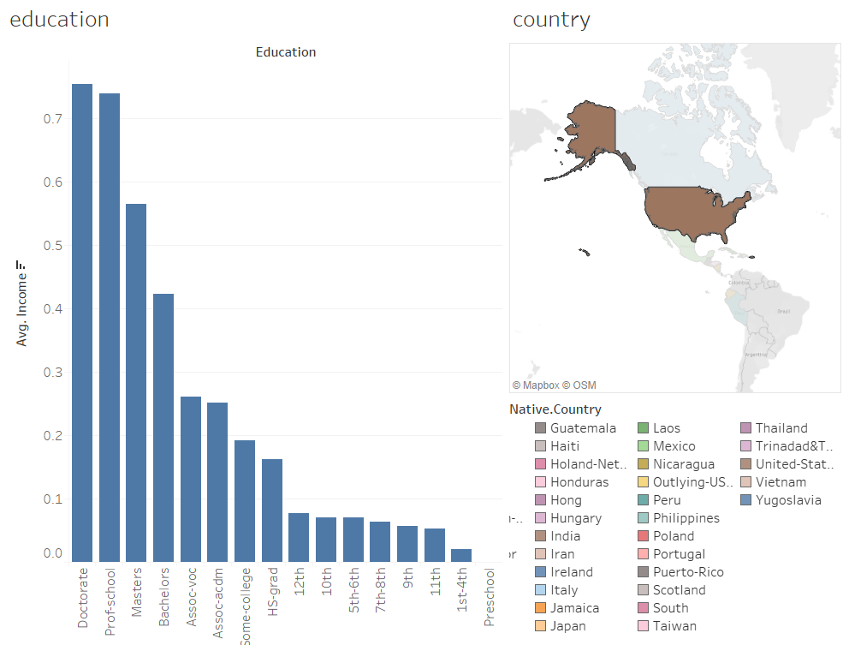
Statistical analysis
Important factors: 1. Education 2. Age
In China, if you want to make money, you’d better get a Phd
In US, it’s not the case, professional school can earn more than a master
9

Slide 10
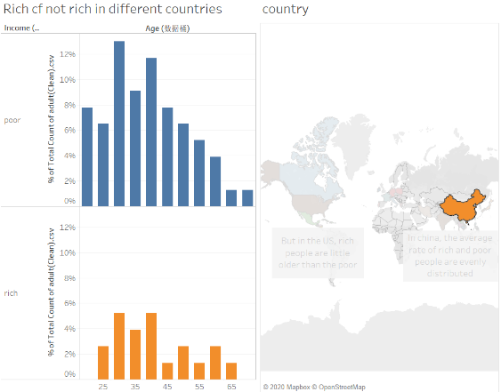
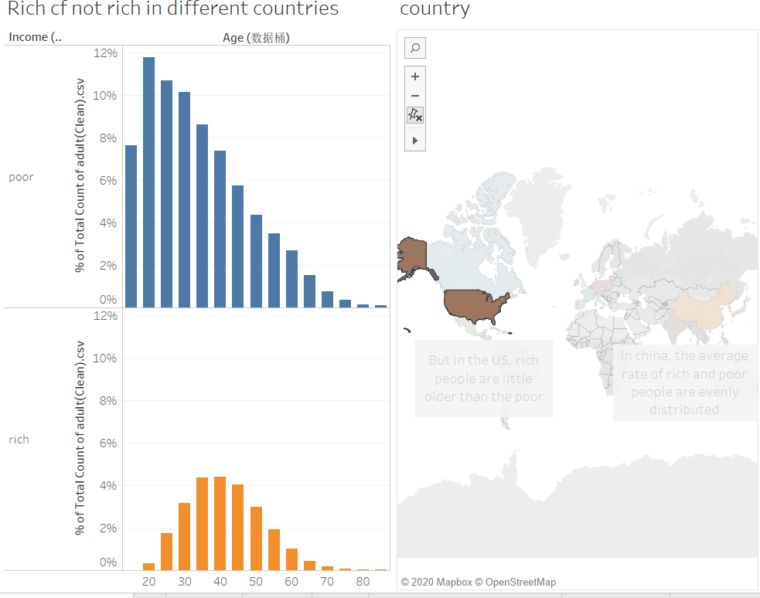
Statistical analysis
Important factors: 1. Education 2. Age
In China, some young people maybe very rich
In US, you get rich when you become ‘older’
10

Slide 11
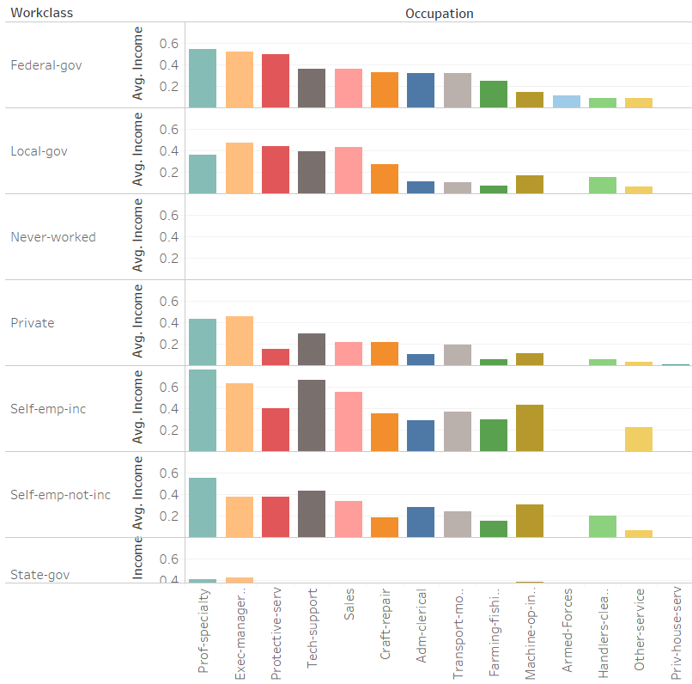
Statistical analysis
Other factor: 1. Occupation
Not bad
Ideal
11

Slide 12
Secret to become rich
Rich family
OK, enjoy your life
If
China
Get married
Phd
Yes
eIif
Set up your company
If you want to be rich
Get married
either
US
Phd or
Professional
You’d better work
No
or
OK, enjoy your life
Work for government
12

Slide 13
Thank you.

